Slide 1
From Principles to Actions: High-Leverage Implementation Actions
Diane J. Briars
Immediate Past President
National Council of Teachers of Mathematics
dbriars@nctm.org

Slide 2
National Council of Teachers of Mathematics www.nctm.org

Slide 3
National Council of Teachers of Mathematics www.nctm.org
National Council of Teachers of Mathematics www.nctm.org
For $144 per year, your school will get a FREE print-only subscription to one of the following award-winning journals:
Five FREE E-Memberships for teachers in your school
All the benefits of an e-membership including full access to
the digital edition of Teaching Children Mathematics or Mathematics Teaching in the Middle School (a $72 value!) FREE!
To involve more teachers, additional e-memberships can be added
for just $10 each.

Slide 4
National Council of Teachers of Mathematics www.nctm.org
National Council of Teachers of Mathematics www.nctm.org
New Member Discount
$20 off for full membership
$10 off e-membership
$5 off student membership
Use Code: BDB0616

Slide 5
2016 Interactive Institutes
Engaging Students in Learning: Mathematical Practices
Atlanta, July 11-13 (Grades K-8)
Atlanta, July 14-16 (Grades 9-12)

Slide 6
2016 Interactive Institutes
Algebra Readiness
Denver, July 18-20 (Grades K-8)
Number and Operations
Denver, July 18-20 (pre-K–5)

Slide 7
NCTM Regional Conferences
Phoenix
October 26-28
Philadelphia
October 31–November 2

Slide 8
Community. Collaboration. Solutions.
Bring your team and engage in a hands-on, interactive, and new learning experience for mathematics education.
With a focus on “Engaging the Struggling Learner,” become part of a team environment and navigate your experience through three different pathways:
Response to Intervention (RtI)
Supporting productive struggle
Motivating the struggling learner

Slide 9
NCTM Conferences www.nctm.org
2017 Annual Meeting and Exposition
April 5–8, 2017
San Antonio

Slide 11
Your Feelings Looking Ahead?

Slide 12
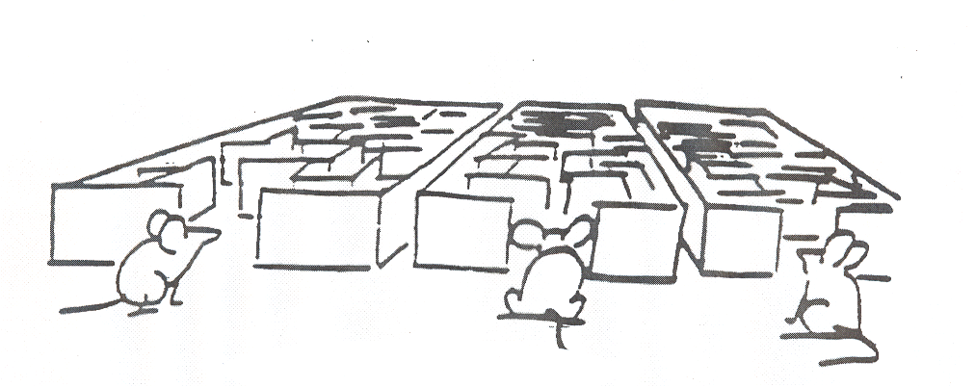
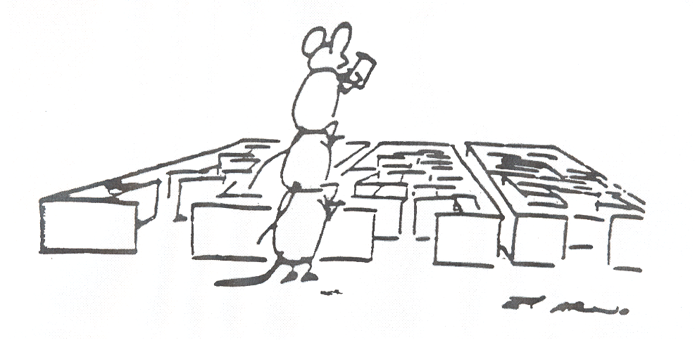

Slide 13
Guiding Principles
for School Mathematics
Teaching and Learning
Access and Equity
Curriculum
Tools and Technology
Assessment
Professionalism
Essential Elements
of Effective Math
Programs

Slide 14
Guiding Principles for School Mathematics
Professionalism
In an excellent mathematics program, educators hold themselves and their colleagues accountable for the mathematical success of every student and for their personal and collective professional growth toward effective teaching and learning of mathematics.

Slide 15
Guiding Principles for School Mathematics
Professionalism
In an excellent mathematics program, educators hold themselves and their colleagues accountable for the mathematical success of every student and for their personal and collective professional growth toward effective teaching and learning of mathematics.

Slide 16
Professionalism Obstacle
In too many schools, professional isolation severely undermines attempts to significantly increase professional collaboration … some teachers actually embrace the norms of isolation and autonomy. A danger in isolation is that it can lead to teachers developing inconsistencies in their practice that in turn can create inequities in student learning.
Principles to Actions, p. 100

Slide 17
Incremental Change
The social organization for improvement is a profession learning community organized around a specific instructional system. A. S. Bryk (2009)
The unit of change is the teacher team.

Slide 18
Collaborative Team Work
An examination and prioritization of the mathematics content and mathematics practices students are to learn.
The development and use of common assessments to determine if students have learned the agreed-on content and related mathematical practices.
The use of data to drive continuous reflection and instructional decisions.
The setting of both long-term and short-term instructional goals.
Development of action plans to implement when students demonstrate they have or have not attained the standards.
Discussion, selection, and implementation of common research-informed instructional strategies and plans.
Principles to Actions, pp. 103-104

Slide 19
Collaborative Team Work
An examination and prioritization of the mathematics content and mathematics practices students are to learn.
The development and use of common assessments to determine if students have learned the agreed-on content and related mathematical practices.
The use of data to drive continuous reflection and instructional decisions.
The setting of both long-term and short-term instructional goals.
Development of action plans to implement when students demonstrate they have or have not attained the standards.
Discussion, selection, and implementation of common research-informed instructional strategies and plans.
Principles to Actions, pp. 103-104

Slide 20
Guiding Principles for School Mathematics
Assessment
An excellent mathematics program ensures that assessment is an integral part of instruction, provides evidence of proficiency with important mathematics content and practices, includes a variety of strategies and data sources, and informs feedback to students, instructional decisions and program improvement.

Slide 21
Guiding Principles for School Mathematics
Assessment
An excellent mathematics program ensures that assessment is an integral part of instruction, provides evidence of proficiency with important mathematics content and practices, includes a variety of strategies and data sources, and informs feedback to students, instructional decisions and program improvement.

Slide 22
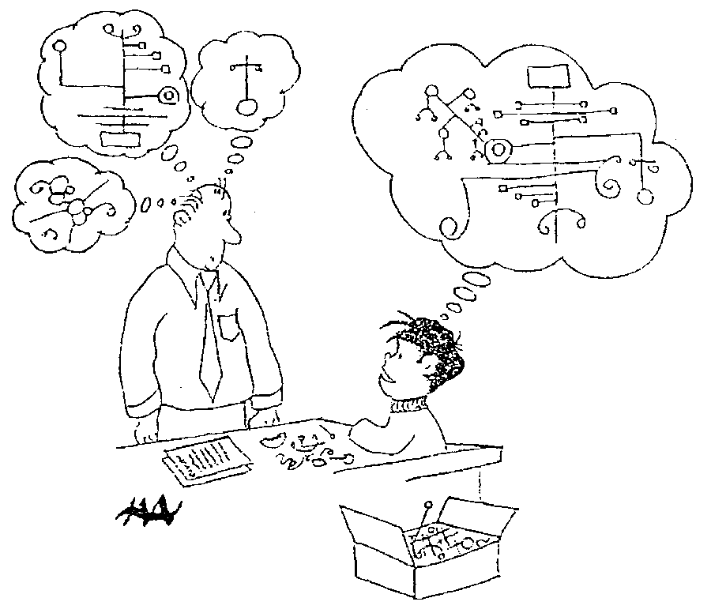
Harold Asturias, 1996
Notes:
This cartoon illustrates what assessment is really about.
Each student develops some concept of mathematics is. Our jobs as teachers and administrators is to figure out what is going on in our students heads.
What do they really understand about mathematics? Unfortunately we can’t just open up the kid’s head and look.
We are restricted to look at visible and tangible evidence---what they say and do. In classrooms, we have a wide variety of evidence available for us.
At the district level, we are often stuck with what kids actually do, often on on-demand types of test.
A critical question is how good are our inferences? To what extent are we actually developing a accurate perception of what kids actually know?
This is what we are call valid inferences. We are making inferences of what children know when our idea of what they know matches, as well as possible, to what they actually understand. We never want to assume that they know something that they don’t, and we also don’t want to assume that they don’t know something that they do.

Slide 23
How Would You Assess This Standard?
6.G. Find the area of right triangles, other triangles, special quadrilaterals, and polygons by composing into rectangles or decomposing into triangles and other shapes; apply these techniques in the context of solving real-world and mathematical problems.
What assessment tasks would you use to assess students’ proficiency with this standard?

Slide 24
How Would You Assess This Standard?
6.G. Find the area of right triangles, other triangles, special quadrilaterals, and polygons by composing into rectangles or decomposing into triangles and other shapes; apply these techniques in the context of solving real-world and mathematical problems.
Compute area of different figures?
Explain the relationship between the areas of different figures?
Find a missing side of a rectangle or base/height of a triangle, given the area and another side?

Slide 25
How Would You Assess This Standard?
6.G. Find the area of right triangles, other triangles, special quadrilaterals, and polygons by composing into rectangles or decomposing into triangles and other shapes; apply these techniques in the context of solving real-world and mathematical problems.
What applications?
“A rectangular carpet is 12 feet long and 9 feet wide. What is the area of the carpet in square feet?”

Slide 26
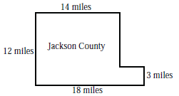
County Concerns
1. The Jackson County Executive Board is considering a proposal to conduct aerial spraying of insecticides to control the mosquito population. An agricultural organization supports the plan because mosquitoes cause crop damage. An environmental group opposes the plan because of possible food contamination and other medical risks.
Here are some facts about the case:
A map of Jackson County is shown here.
All county boundaries are on a S north– south line or an east–west line.
The estimated annual cost of aerial spraying is $29 per acre.
There are 640 acres in 1 square mile.
Plan supporters cite a study stating that for every $1 spent on insecticides, farmers would gain $4 through increased agricultural production.
a. What is the area of Jackson County in square miles? In acres?
b. What would be the annual cost to spray the whole county?
c. According to plan supporters, how much money would the farmers gain from the spraying program?

Slide 27
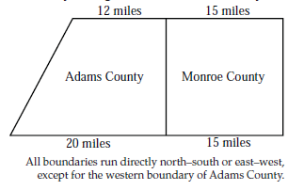
County Concerns
2. The sheriff of Adams County and the sheriff of Monroe County are having an argument. They each believe that their own county is larger than the other county.
Who is right? Write an explanation that would settle the argument.

Slide 28
Tasks Clarify Expectations
Range of content
Depth of knowledge
Type of reasoning and evidence of it
Types of applications

Slide 29
Assessments that Support Valid Inferences
Learning goal:
Understanding the definition of a triangle.
Performance task:
Draw a triangle.

Slide 30
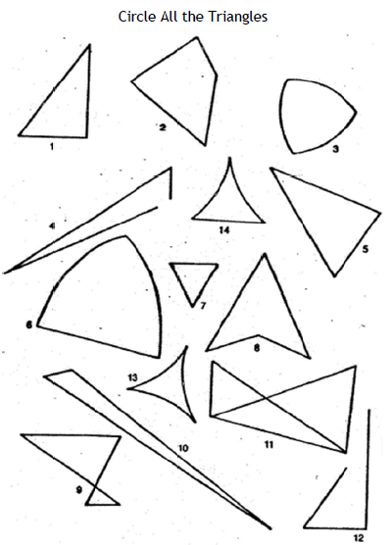

Slide 31
Analyzing Assessment Tasks
To what extent does the task:
Provide valid information about students’ knowledge?
Provide information about students’ conceptual understanding?
Provide information about students’ proficiency in mathematical processes: problem solving, reasoning and proof, communication, connections, and representation?

Slide 32
Understanding a Concept
Explain it to someone else
Represent it in multiple ways
Apply it to solve simple and complex problems
Reverse givens and unknowns
Compare and contrast it to other concepts
Use it as the foundation for learning other concepts

Slide 33
Common Assessment Planning Process
Plan
Develop
Administer and Analyze Students’ Performance
Critique
Revise

Slide 34
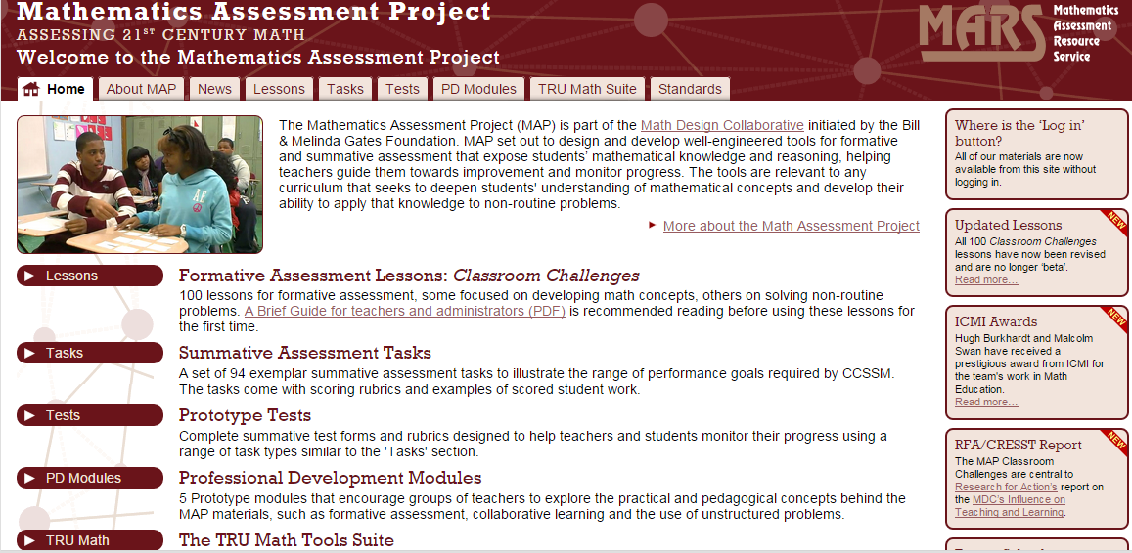
http://map.mathshell.org/

Slide 35
http://www.insidemathematics.org/performance-assessment-tasks

Slide 36
Collaborative Team Work
An examination and prioritization of the mathematics content and mathematics practices students are to learn.
The development and use of common assessments to determine if students have learned the agreed-on content and related mathematical practices.
The use of data to drive continuous reflection and instructional decisions.
The setting of both long-term and short-term instructional goals.
Development of action plans to implement when students demonstrate they have or have not attained the standards.
Discussion, selection, and implementation of common research-informed instructional strategies and plans.
Principles to Actions, pp. 103-104

Slide 37
Effective
Mathematics Teaching Practices
Establish mathematics goals to focus learning.
Implement tasks that promote reasoning and problem solving.
Use and connect mathematical representations.
Facilitate meaningful mathematical discourse.
Pose purposeful questions.
Build procedural fluency from conceptual understanding.
Support productive struggle in learning mathematics.
Elicit and use evidence of student thinking.

Slide 38
Effective
Mathematics Teaching Practices
Establish mathematics goals to focus learning.
Implement tasks that promote reasoning and problem solving.
Use and connect mathematical representations.
Facilitate meaningful mathematical discourse.
Pose purposeful questions.
Build procedural fluency from conceptual understanding.
Support productive struggle in learning mathematics.
Elicit and use evidence of student thinking.

Slide 39
Facilitate Meaningful Mathematical Discourse
Mathematical Discourse should:
Build on and honor students’ thinking.
Let students share ideas, clarify understandings, and develop convincing arguments.
Engage students in analyzing and comparing student approaches.
Advance the math learning of the whole class.

Slide 40
Leaves and Caterpillars
A fourth-grade class needs five leaves each day to feed its 2 caterpillars.
How many leaves would they need each day for 12 caterpillars?

Slide 41
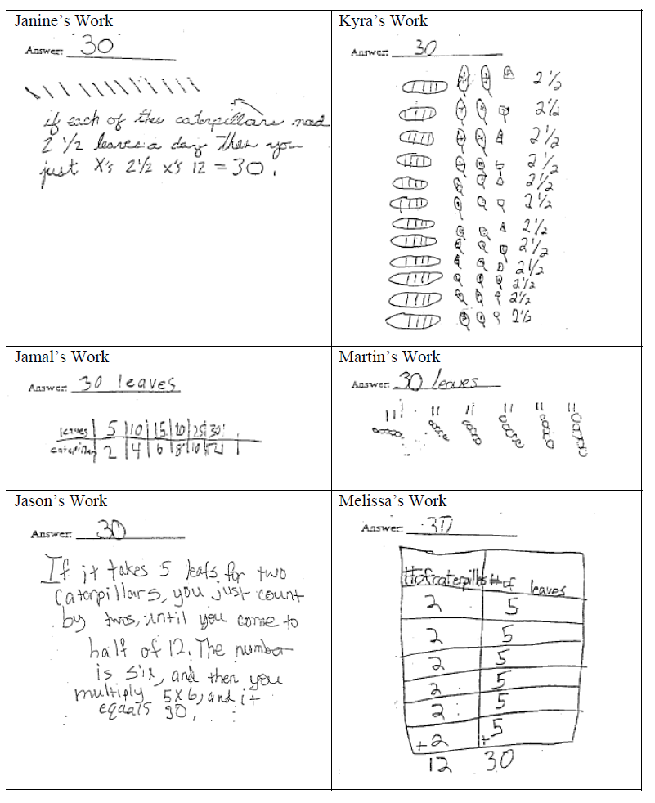
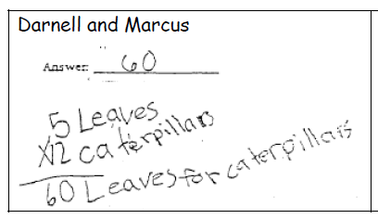
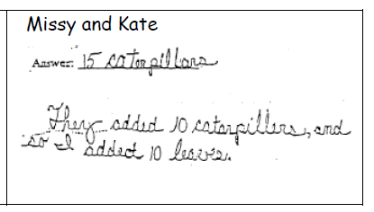

Slide 42
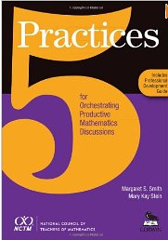
Five Practices for Orchestrating Effective Discussions
Anticipating likely student responses
Monitoring students’ actual responses
Selecting particular students to present their mathematical work during the whole class discussion
Sequencing the student responses
Connecting different students’ responses—to each other and to key mathematical ideas.
Smith & Stein, 2011
Smith & Stein, 2011

Slide 43
Planning with the Student in Mind
Anticipate solutions, thoughts, and responses that students might develop as they struggle with the problem
Generate questions that could be asked to promote student thinking during the lesson, and consider the kinds of guidance that could be given to students who showed one or another types of misconception in their thinking
Determine how to end the lesson so as to advance students’ understanding
Stigler & Hiebert, 1997

Slide 44
Access and Equity Principle
An excellent mathematics program requires that all students have access to a high-quality mathematics curriculum, effective teaching and learning, high expectations, and the support and resources needed to maximize their learning potential.

Slide 45
Access and Equity Principle
An excellent mathematics program requires that all students have access to a high-quality mathematics curriculum, effective teaching and learning, high expectations, and the support and resources needed to maximize their learning potential.

Slide 46
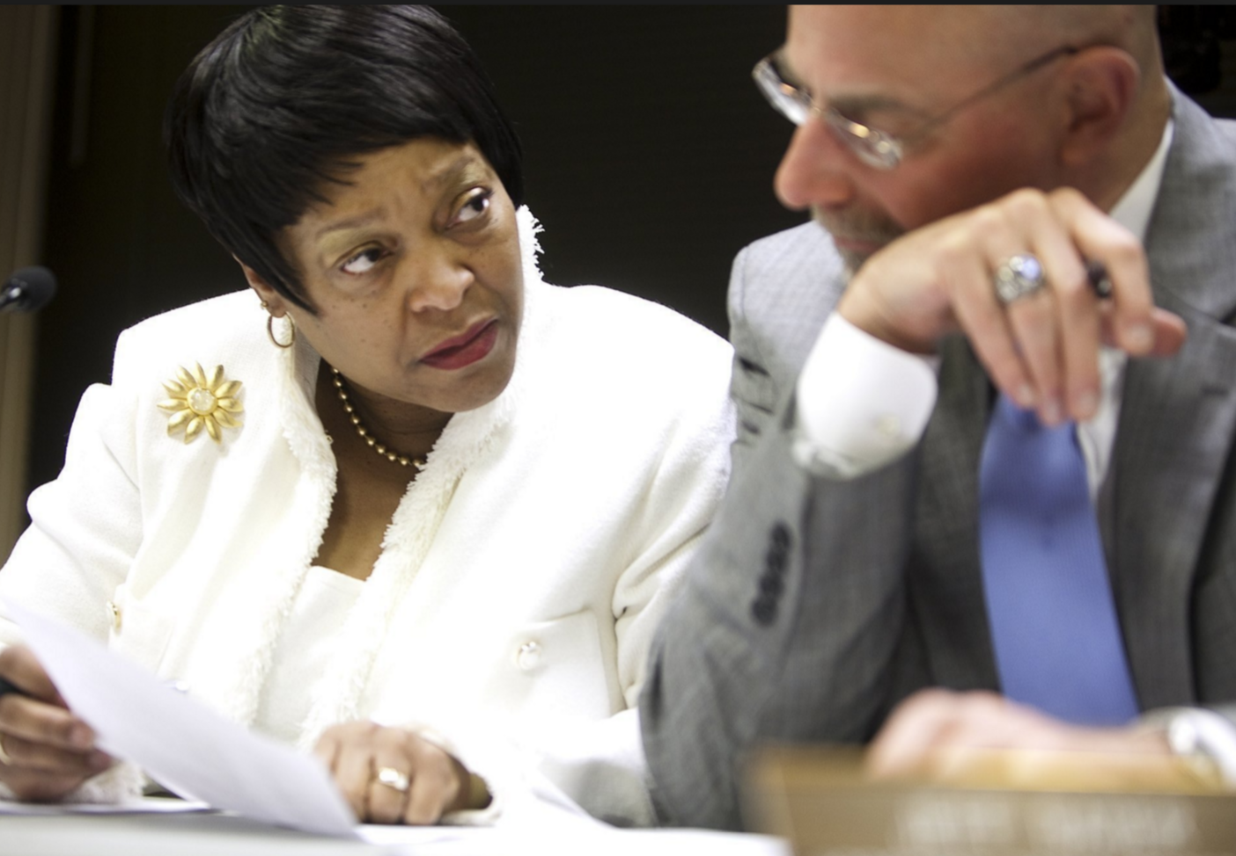
Access and Equity Principle
Act on two fronts:
Administrators
Teachers

Slide 47
Self Assessment as a Mathematics Learner
Please write down at least three adjectives which describe you as a mathematics learner.
Also think about the factors, which helped to shape these beliefs about yourself as a learner and doer of mathematics.
Briefly share what you wrote and why.
Notes:
Ask participants to write down three adjectives which they believe describes themselves as mathematics learners.
Next ask participants to share what they wrote. Note how their beliefs about themselves as mathematics learners were impacted by their opportunities to learn mathematics and the environments in which learning did or did not take place.

Slide 48
Students’ Mathematics Identities
Are how students see themselves and how they are seen by others, including teachers, parents, and peers, as doers of mathematics.
Aguirre, Mayfield-Ingram & Martin, 2013

Slide 49
Mathematics Identity
Mathematics identity includes:
beliefs about one’s self as a mathematics learner;
one’s perceptions of how others perceive him or her as a mathematics learner,
beliefs about the nature of mathematics,
engagement in mathematics, and
perception of self as a potential participant in mathematics (Solomon, 2009).

Slide 50
What Messages Are We Sending About Mathematical Identity?
Implicit as well as explicit messages:
Who works with whom?
Who gets to share their work?
Who gets asked higher-level questions vs. lower-level questions?
How is productive struggle supported?
To what extent are struggle, partial understandings, incorrect answers viewed as learning opportunities?

Slide 51
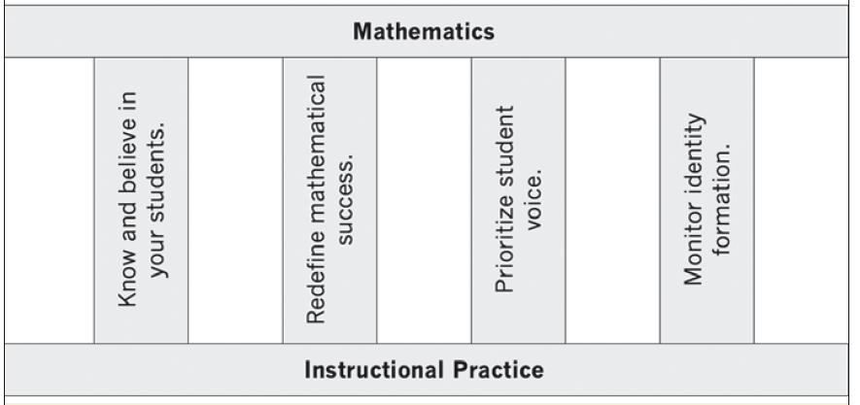
Four Pillars of Practice to Support Mathematics Identity
Allen & Schnell, MTMS, March, 2016

Slide 52
Four Pillars of Practice to Support Mathematics Identity
Givens:
Students work in groups.
Invest in classroom community
Engage in tasks that promote reasoning and problem solving
Goal: Promoting equity, ensuring a few students do not dominate discussion.
Students keep journals including reflections
Teacher a facilitator and co-learning
Communicate high expectations
For every student to learn mathematics
For every student to contribute to the mathematics learning of others.
Allen & Schnell, MTMS, March, 2016

Slide 53
Four Pillars of Practice to Support Mathematics Identity
Know and believe in your students:
Make an effort to understand students’ life circumstances.
Viewing student attributes as assets rather than deficits.
Have students create a “mathography”.
Allen & Schnell, MTMS, March, 2016

Slide 54
Four Pillars of Practice to Support Mathematics Identity
Redefine mathematical success:
Recognize contributions skills and talents each student brings to collective mathematical work.
Relating a new problem to a previous problem
Connecting multiple ideas
Representing an idea in a new way
Asking an insightful question
Listening carefully and restating someone’s thinking
Allen & Schnell, MTMS, March, 2016

Slide 55
Four Pillars of Practice to Support Mathematics Identity
Prioritize student voice:
Limit broadcast questioning.
Establish routines that help students develop ideas privately and express them in a small group before presenting publicly.
Leverage formative assessment and self-assessment.
Have students help set goals and learning targets.
Allen & Schnell, MTMS, March, 2016

Slide 56
Four Pillars of Practice to Support Mathematics Identity
Monitor identify formation:
Formative assessment to give us information to improve instruction.
Teach students to self-assess, including assessing beliefs about mathematics learning.
Journals as running record of students growth
Allen & Schnell, MTMS, March, 2016

Slide 57
Promoting Growth Mindsets
Teacher praise influences mindsets
Fixed: Praise refers to intelligence
Growth: Praise refers to effort, engagement, perseverance
Explicit instruction about the brain, its function, and that intellectual development is the result of effort and learning has increased students’ achievement in middle school mathematics.
Reading stories of struggle by successful individuals can promote a growth mindset

Slide 58
Guiding Principles
for School Mathematics
Teaching and Learning
Access and Equity
Curriculum
Tools and Technology
Assessment
Professionalism
Essential Elements
of Effective Math
Programs

Slide 59
New NCTM Tools Activities with Rigor and Coherence (ARCs)
Sequence of 2–4 lessons that
Support Principles to Actions
Address a specific math topic
Scaffold effective teaching
Support the 8 SMPs
Demonstrate the 5 Practices for Orchestrating Productive Mathematics Discussions
Integrate the wide array of NCTM resources
Notes:
Read through each bullet point
After the “integrates…. NCTM resources,” say that, at the first meeting, we started with Illuminations lesson plans that needed revamping.
You might consider asking who has heard of Illuminations, provide background (if necessary).
Make it clear that Illuminations site (and Calculation Nation too) are NCTM sites.
Next slide will show the lesson that was transformed, if applicable.

Slide 60
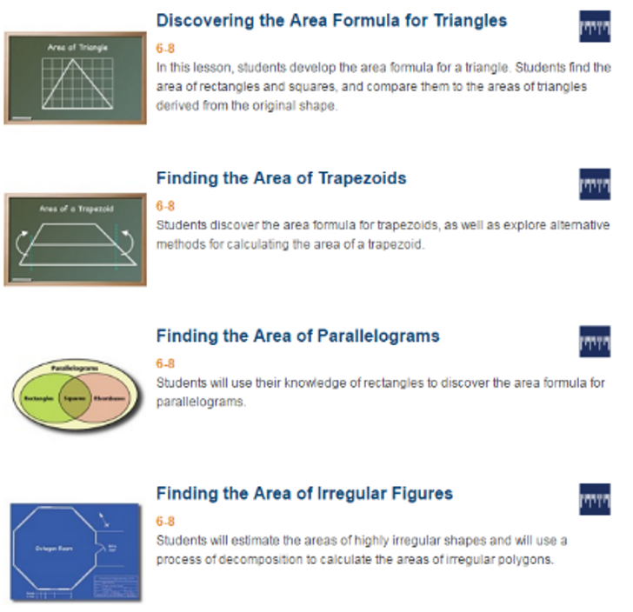
Discovering Area Relationships
of Polygons
Notes:
NOTE: This is actually going to be a WHOLE LOT of slides! You may choose to ask them to go through the “Hook” for example, first. You choose what’s best for all of these middle slides. ☺

Slide 61
www.nctm.org/ARCs/

Slide 63
The Title Is Principles to Actions
Your Actions?

Slide 64
Thank You!
Diane Briars
dbriars@nctm.org
nctm.org/briars

